Slide 1
Forgetful Friend – RFID Reader
BAMS Designs
Bethel Yohannes, Amelia Lopez,
Michelle Sung,
Sophia Li

Slide 2
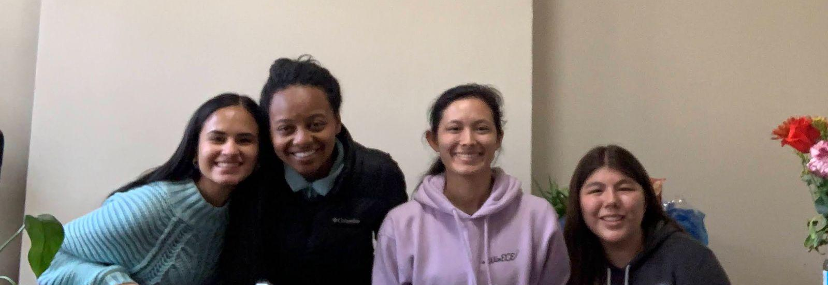
Our Team
Amelia Lopez
Bethel Yohannes
Sophia Li
Mimi Sung
Senior in ECE
Hardware Devices
Senior in ECE
Full Stack Designer
Senior in ECE
Hardware Devices
Junior in Envi
Structure building
tinyurl.com/Build18-RFID-Reader

Slide 3
01
Why this Project?

Slide 4
“Who wants to take a 40 minute detour because they forgot their notebook at home? Not me.”
—BASM Designs
tinyurl.com/Build18-RFID-Reader

Slide 5

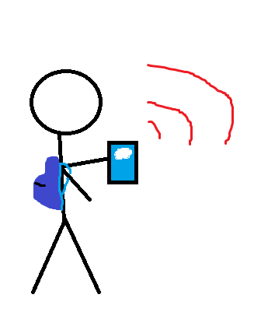
Why this project?
Education illustrations by Storyset
tinyurl.com/Build18-RFID-Reader
Notes:
As students, there is a lot going on in our lives. Between classes, clubs, jobs, and friends, we are constantly committing ourselves to a packed schedule. Why not make a tool to help with some mental workload while ensuring we don’t waste our precious time?
For your forgetful Friend
Our tool helps prepare you for your day be letting you know if you left something at home by reading RFID tags on all your important items.

Slide 6
02
Original Idea
tinyurl.com/Build18-RFID-Reader

Slide 7

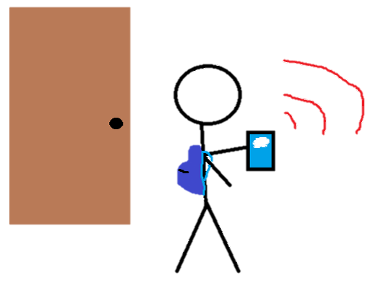
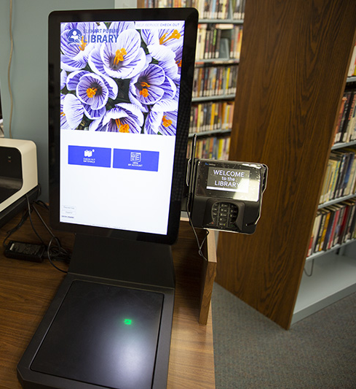
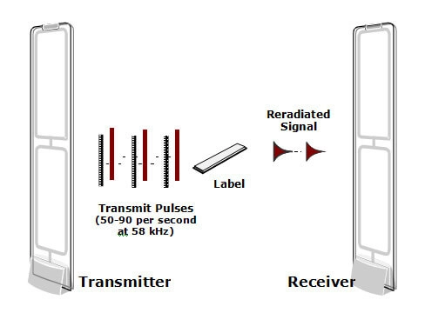
Ideas
Library book checkout
To …
Forget friend check-in
https://www.myepl.org/self-checkout-now-available-at-epl/
https://www.td.org/newsletters/atd-links/four-open-door-leadership-skills
https://www.magestore.com/blog/how-do-store-alarms-work/
tinyurl.com/Build18-RFID-Reader

Slide 8
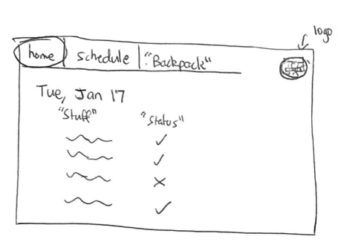
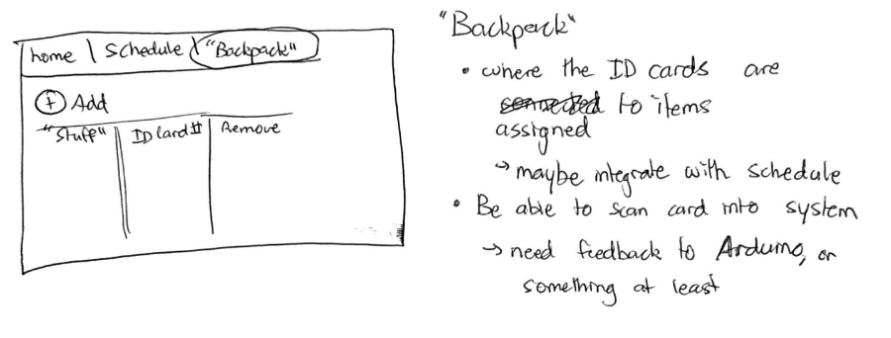
Website Idea
 | Monday | Tuesday | Wednesday | Thursday
Computer
Class 101 Notebook |  | — — —
Charger
tinyurl.com/Build18-RFID-Reader

Slide 9
03
Building the System

Slide 10
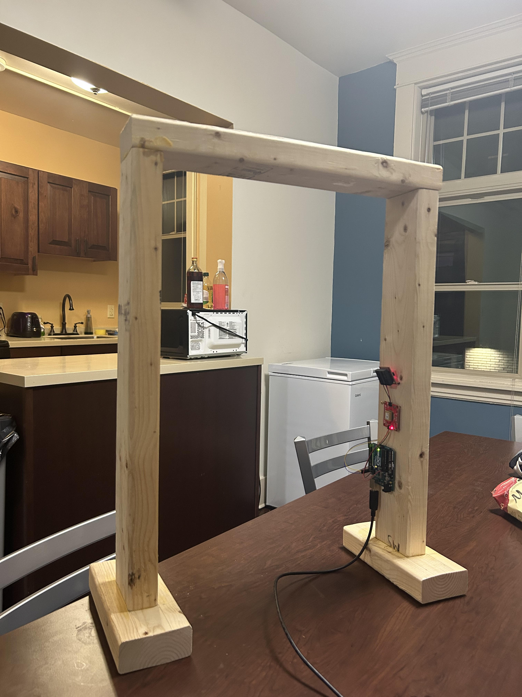
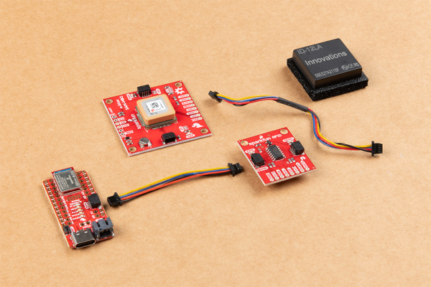
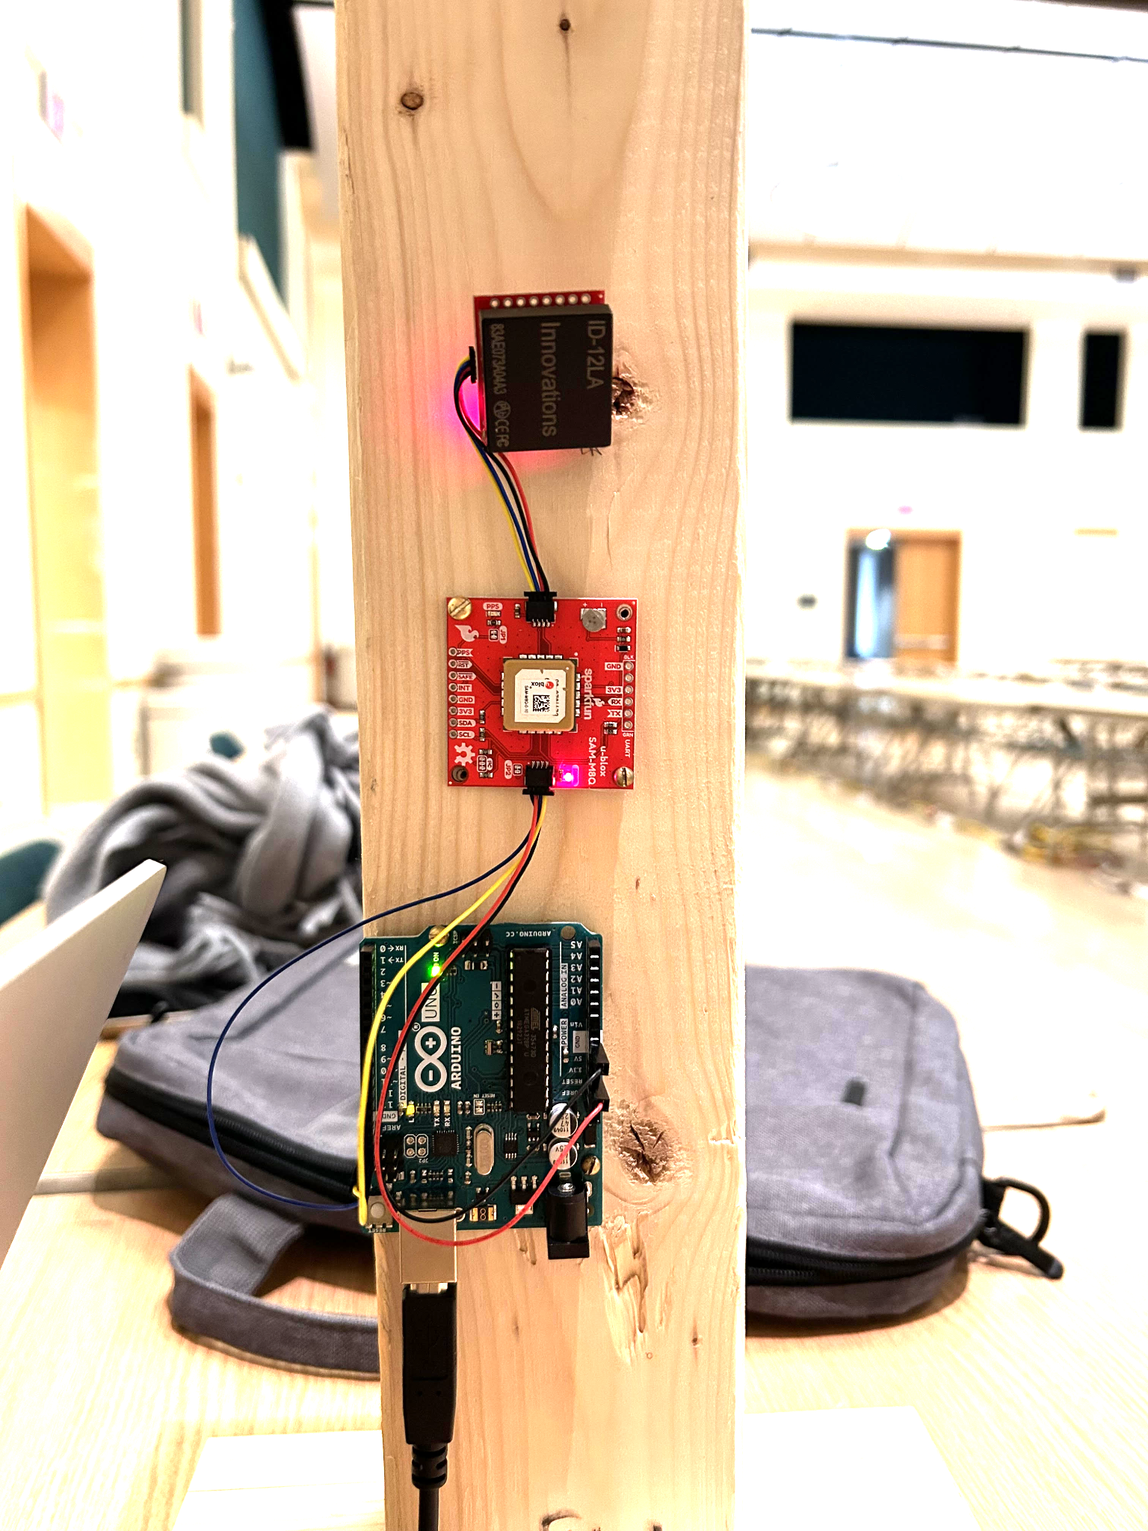
The “Door” and the RFID Reader
https://learn.sparkfun.com/tutorials/rfid-beginners-tutorial?_ga=2.76843026.684133941.1674399771-773774779.1673884067
tinyurl.com/Build18-RFID-Reader

Slide 11
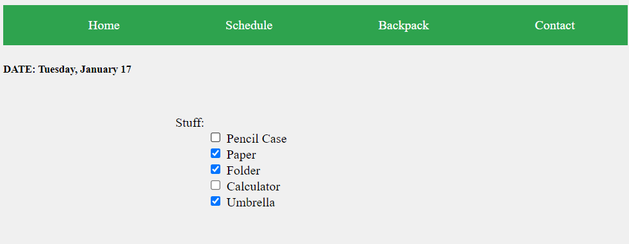
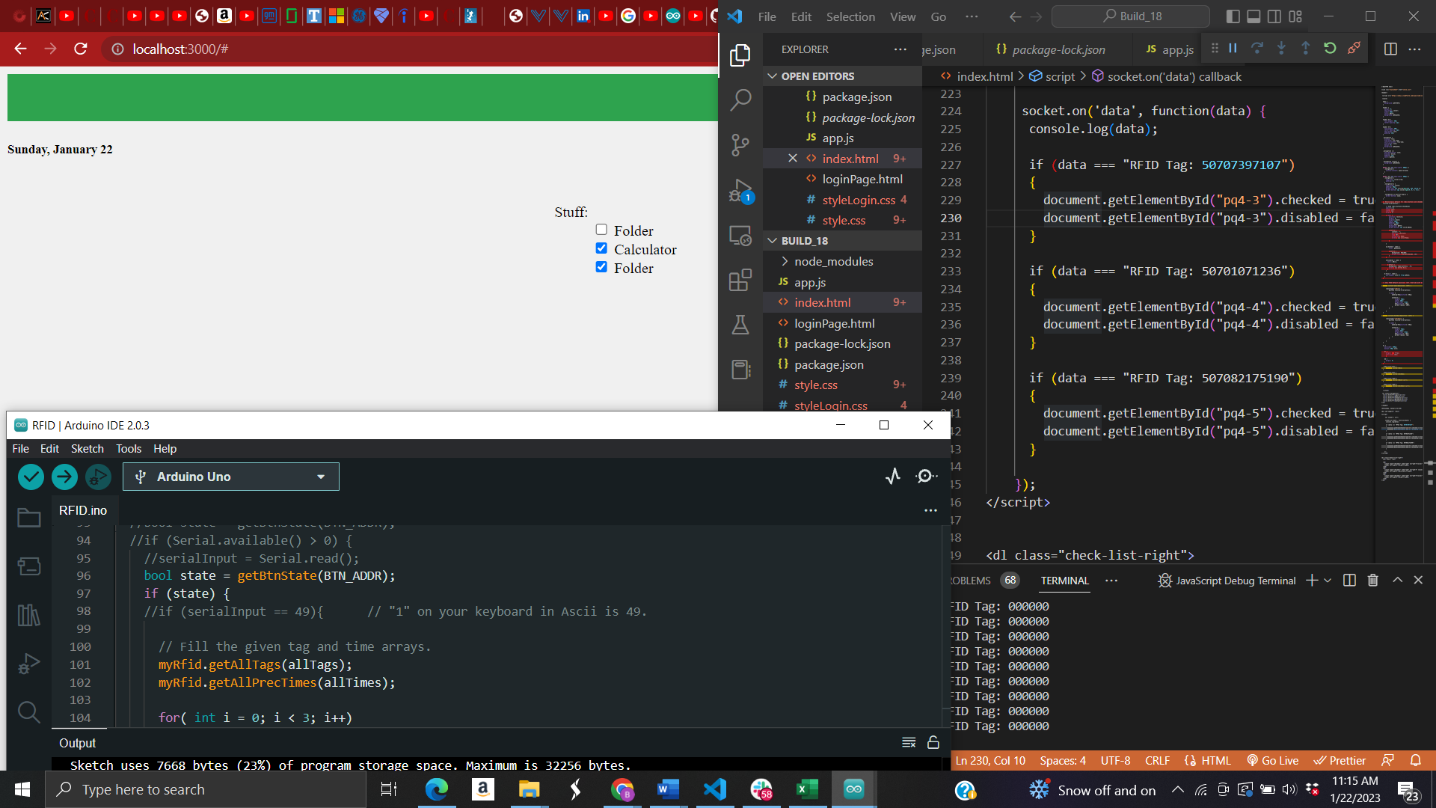
Website
tinyurl.com/Build18-RFID-Reader

Slide 12
Demo
tinyurl.com/Build18-RFID-Reader

Slide 13
THANKS
in/bethel-yohannes/
in/amelia-lopez/
in/michelle-sung-978662221/
in/sophia-a-li
Do you have any questions?
Slides: tinyurl.com/Build18-RFID-Reader
GitHub: https://github.com/BAMS-Designs
Please keep this slide for attribution
tinyurl.com/Build18-RFID-Reader

Slide 14
The Slide Title Goes Here
Do you know what helps you make your point clear? Lists like this one:
They’re simple
You can organize your ideas clearly and easily
You’ll never forget to buy milk again!
And the most important thing: the audience won’t miss the point of your presentation
Here you can enter a subtitle if you need it

Slide 15
05
OPERATING PLAN

Slide 16
06
FINANCIAL PLAN

Slide 17





Storyset by Freepik
Create your Story with our illustrated concepts. Choose the style you like the most, edit its colors, pick the background and layers you want to show and bring them to life with the animator panel! It will boost your presentation. Check out How it Works.
Pana
Amico
Bro
Rafiki
Cuate

Slide 18


